Slide 1
AI and machine learning:
the map before the route
What do I need to understand about AI before I decide anything about it?
Applied AI and Automation | Session 0 of the 15, the introduction
KLAi Professional Learning | Jotham Martin Wambi
Notes:
Welcome, and thank you for being here. This is the first session of the course, so there is no earlier session to build on. Before we build anything, we spend it on the ideas that sit under everything else: how AI and machine learning actually work, what the fields and jobs are, and why a company leader needs this picture.
There are no exercises today. You leave with a handbook to read before Session 1.

Slide 2



Today in one view: what you will leave with
By the end of today you will have
A clear picture of how AI works, how a model is measured and what happens behind a chat answer
A map of the fields, the jobs and the tools behind AI work in a company
Your Course Handbook and a clear picture of the 14 sessions ahead
Notes:
That question gives us three things to aim for. A clear picture of how AI works, how a model is measured and what happens behind a chat answer. A map of the fields, the jobs, the data and the costs behind AI work in a company. And your handbook, to read before Session 1. Nothing to submit and nothing to be tested on.

Slide 3
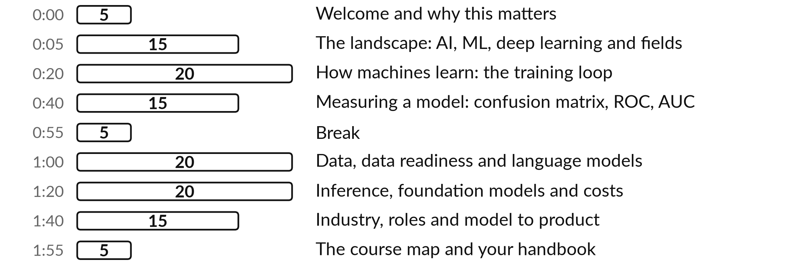
Your two hours: ideas and questions, no activities
There are no exercises today. Stop me at any point with a question.
Notes:
Here is how the two hours are shaped. Today is for understanding, so there are no exercises. The first half covers how AI and machine learning work and how a model is measured. After the break come data readiness, what happens behind a chat message, foundation models and costs, and then industry, roles and the road ahead.
It is a full session, so keep a note of any question we have to park. Ask when it comes to you. It will help everyone.

Slide 4





Words we use today
Word | What it means
Model | A function with adjustable parameters that has learned patterns from data and makes predictions.
Parameters | All the weights and biases of a model: the numbers that training adjusts.
Training | Repeating predict, measure the loss, update the parameters, until the loss is small.
Inference | Using a trained model to make a prediction or generate an answer.
Overfitting | When a model fits its training data, noise included, and does worse on new data.
Notes:
Five words for today. I give the plain meaning of each, and we use every one of them before the end of the session.
Model. A function with adjustable parameters that has learned patterns from data and makes predictions.
Parameters. All the weights and biases of a model: the numbers that training adjusts.
Training. Repeating predict, measure the loss, update the parameters, until the loss is small.
Inference. Using a trained model to make a prediction or generate an answer.
Overfitting. When a model fits its training data, noise included, and does worse on new data.
Keep those words close. The first idea uses them straight away, so let us begin.

Slide 5



Today gives you the words and the
picture that every later session uses
You can judge a vendor claim when you know how the thing learns.
You can choose a good first task when you know what AI is good at.
You can check a result when you know why models fail.
You can ask your team sharp questions when you know who does what.
Notes:
With those five words in your pocket, let me say why this session matters. Executives who skip the basics tend to be swayed by confident vendors and confident-sounding tools. Four things change once you have the picture. You can judge a vendor’s claim, because you know how the thing learns.
You can choose a good first task, because you know what AI is good at. You can check a result, because you know why models fail. And you can question your team well, because you know who does what. Which of those would help you most this month?

Slide 6
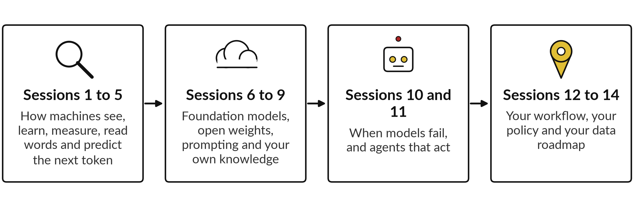
Today’s ideas come back in
every phase of the course
Session 0 is the map. The next fourteen sessions are the route.
Notes:
Whichever one you picked, the course is built to give you all four, so here is the whole course in four steps. First we open the box. Sessions one to five show how a machine sees a picture, learns from examples, is measured, turns words into numbers and predicts the next token.
I demonstrate each idea and you may join in. Then sessions six to nine cover foundation models, open weights, prompting and how to give a model your own knowledge. Sessions ten and eleven show how models fail and how agents act. Finally, in sessions twelve to fourteen, we work on your own workflow, policy and data roadmap. Today is the map. The rest is the route.

Slide 7
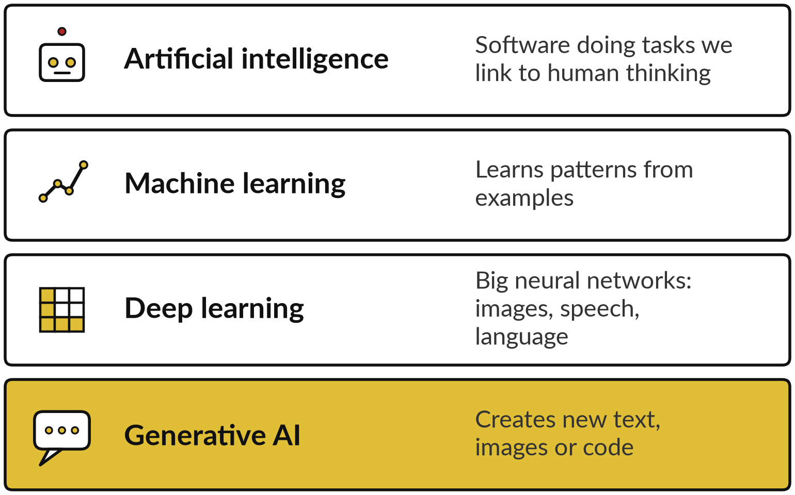
AI is a family: each layer sits inside the one above
Most tools in the news today are generative AI, the innermost layer.
Rules came first: a person writes every step.
Machine learning finds the steps from examples.
Notes:
Our first block is the landscape: what AI is, and where machine learning sits inside it. By the end you can place any tool you hear about on one picture. Start with the family tree. Artificial intelligence is the broad idea: software doing tasks we link with human thinking.
Early AI was rules written by people. Machine learning is a smarter branch: instead of writing every rule, we show the computer examples and it finds the pattern. Deep learning is machine learning using large neural networks, and it is behind most progress in images, speech and language.
Generative AI sits inside that: models that create new text, pictures or code. When someone says AI today, they usually mean that inner circle.

Slide 8







AI has several fields; each one
suits a different business problem
Field | What it does | In a company
Natural language processing (NLP) | Reads and writes human language | Summarise emails, sort enquiries
Computer vision | Understands images and video | Read invoices, check goods in photos
Speech | Turns speech into text and back | Transcribe meetings and calls
Forecasting | Predicts numbers over time | Demand, cash flow, prices
Recommendation | Suggests what a person may want next | Product suggestions, next best offer
Anomaly detection | Spots what does not fit | Fraud, faulty machines
Generative AI | Creates new text, images or code | Draft reports and replies
Notes:
Once you can place the family, the next question is what each branch is used for. Here are the main fields. Natural language processing is working with human language: summarising, sorting and translating. Computer vision reads images, such as invoices or photos of damaged goods. Speech turns calls and meetings into text.
Forecasting predicts numbers over time. Recommendation suggests what to offer next. Anomaly detection spots what does not fit, which is how many fraud alerts work. And generative AI creates drafts. Which of these have you already met in your company, perhaps without calling it AI?

Slide 9


Machines learn in four main ways
Type of learning | How it learns | Everyday example
Supervised | From examples with the correct answer (the label) attached | Spam or not spam; a house price from its features
Unsupervised | Finds groups and structure in data that has no labels | Grouping songs that sound alike
Reinforcement | By trial and error, guided by rewards and penalties | A program learning to play a board game
Self-supervised | Predicts a hidden part of its own data, so the data supplies the labels | Predicting the next word of a sentence
Supervised learning has two kinds. Classification predicts a category, such as spam or not spam. Regression predicts a number, such as a house price.
Notes:
All of those fields rest on machines that learn, so our second block asks how they learn. By the end you can describe the idea in one sentence. There are four standard types. Supervised learning uses training examples, where each row has features, the inputs, and a label, the correct answer: emails marked spam or not spam, or houses with their sale prices.
It comes in two kinds. Classification predicts a category. Regression predicts a number. Unsupervised learning has no labels and finds groups, like songs that sound alike. Reinforcement learning learns by trial, with rewards and penalties. Self-supervised learning hides part of its own data and learns to predict it, which is how language models learn to predict the next token. At work, fraud flags and sales forecasts are supervised.

Slide 10
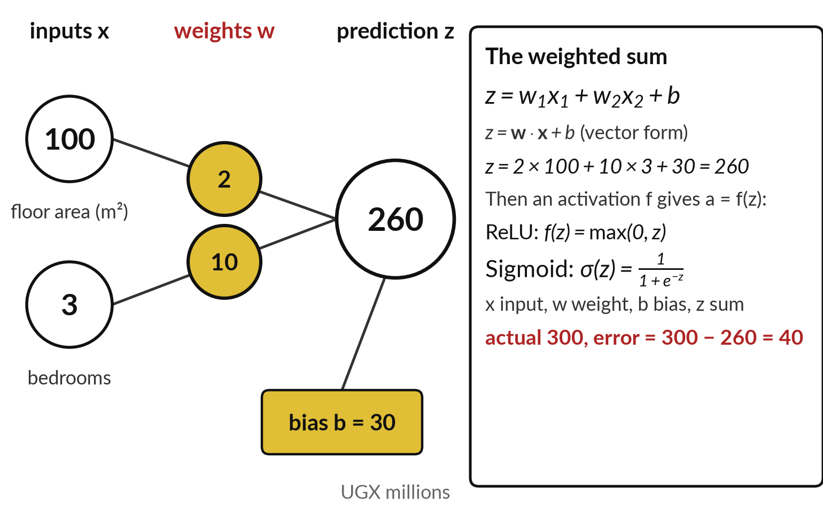
A model is a weighted sum with adjustable
numbers: a house price example
Predict a house price from floor area and bedrooms with a weighted sum plus a bias.
x are inputs (features), w weights, b the bias.
Weights and biases together are the parameters.
Error = actual − prediction = 300 − 260 = 40. Squared, it becomes the loss.
Notes:
Those are the ways a machine learns, so what is the thing that learns?
Take a house price in UGX millions. The inputs, called features, are the floor area, 100 square metres, and the bedrooms, 3. A weight says how much one input counts: 2 million per square metre, 10 million per bedroom. The formula, a weighted sum, reads z equals w1 times x1, plus w2 times x2, plus b.
The bias b, here 30 million, shifts the answer. So 2 times 100, plus 10 times 3, plus 30 gives 260. The house sold for 300, so the error is 40. The weights and bias are the parameters, which training adjusts. A neuron then passes z through an activation function: ReLU returns the larger of zero and z, and the sigmoid squeezes z into a number between 0 and 1. Session 1 uses both.

Slide 11
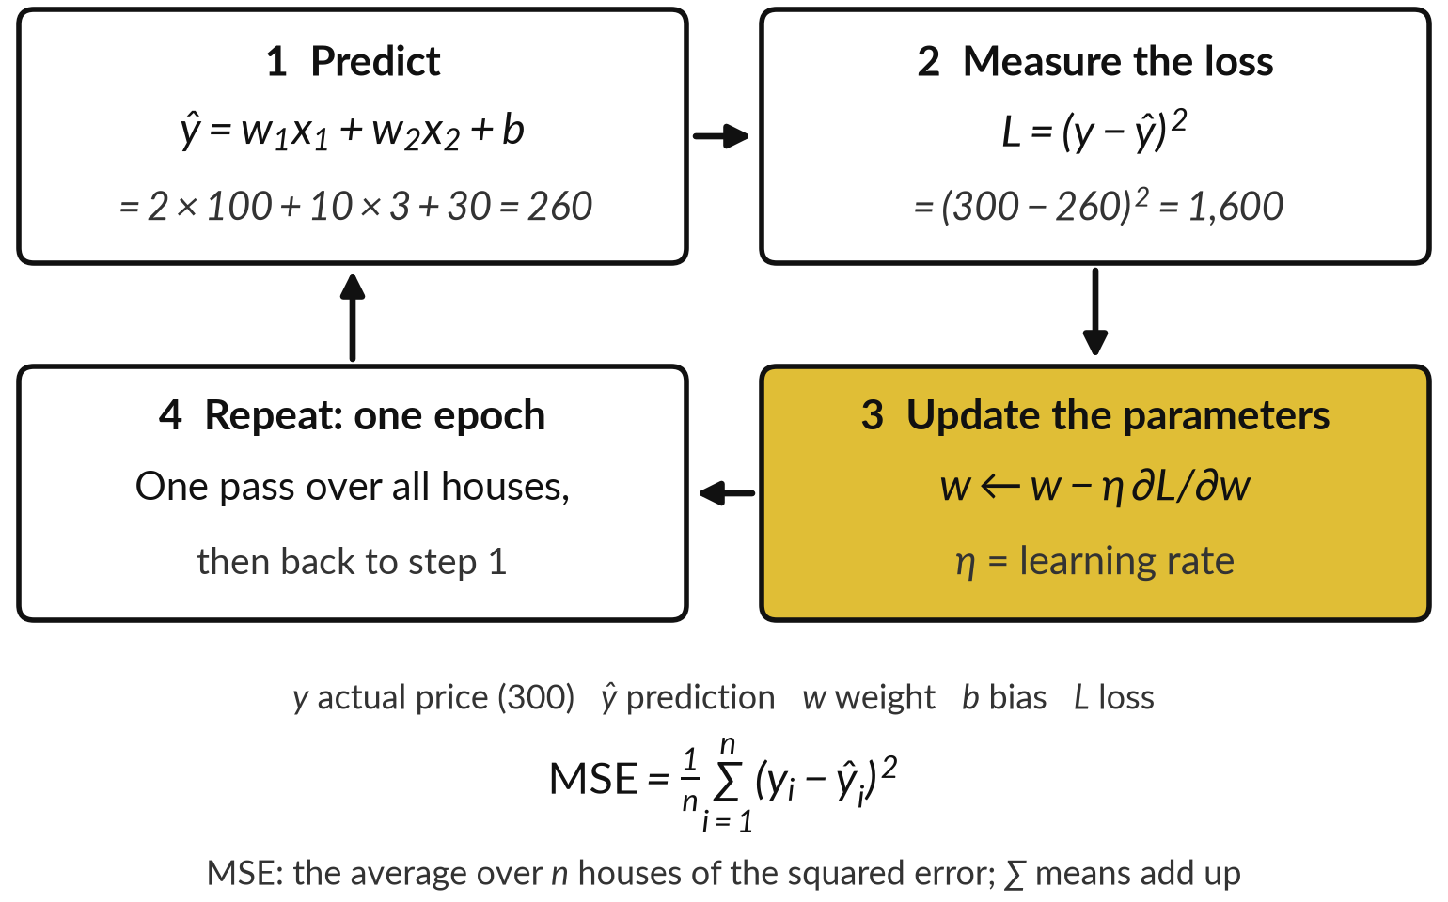
Training is a loop: predict, measure the
loss, update the parameters, repeat
The loss is one number that says how wrong the predictions are. Training tries to make it small.
Parameters start as random numbers.
Squaring the error gives the loss: 40 × 40 = 1,600 for our house.
One full pass over the training data is an epoch.
Notes:
Turning those numbers is not done by hand. Whichever way a machine learns, the machinery underneath is one loop, and this is the core idea of the session. A model starts with random parameters. It predicts a price for every house in the training data. We then measure how wrong it was with a loss function, one number.
For our house the prediction is 260 and the price 300, so the loss is the squared error, 40 squared, which is 1,600. Averaged over n houses, that is the mean squared error. Next, the update: w new equals w old minus eta times the gradient, where eta is the learning rate.
Then repeat. One full pass over the training data is an epoch. But how does it know which way to adjust? The next two slides answer that.

Slide 12
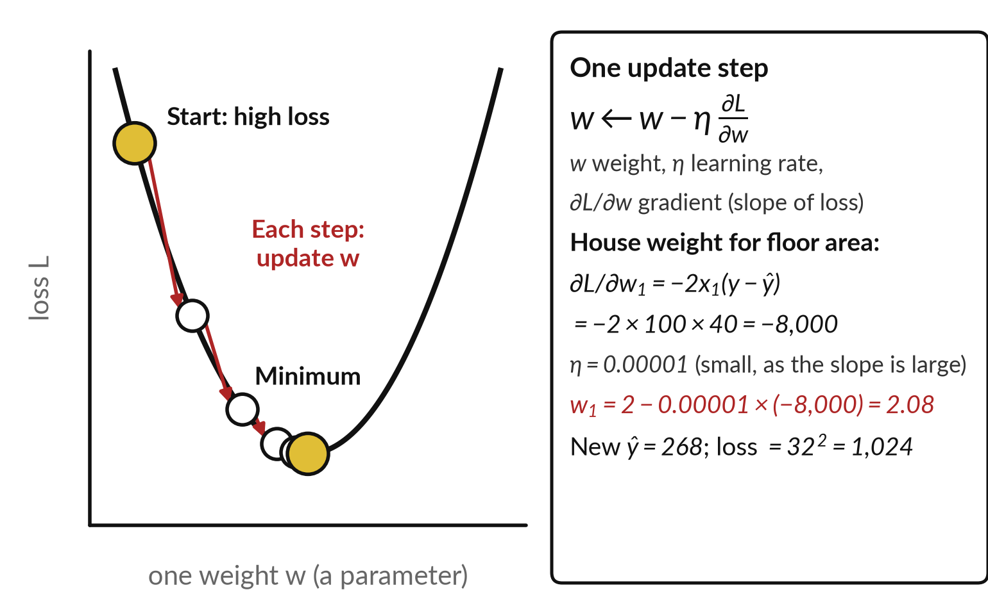
Gradient descent lowers the loss
with small steps against the gradient
The gradient says which way, and how steeply, the loss changes when a weight changes.
Step each weight in the direction that lowers the loss.
The learning rate η is the size of each step: too big overshoots, too small is slow.
It can settle in a local minimum above the lowest point.
Notes:
So how does it know which way to adjust?
Gradient descent is the method. The gradient is the slope of the loss with respect to a weight: it says which direction raises the loss and how steeply. Gradient descent takes a small step the opposite way: w new equals w old minus eta times the gradient. Eta, the learning rate, sets the step size.
For our house, the gradient for the floor-area weight is minus 2 times 100 times 40, which is minus 8,000. With eta 0.00001, the weight moves from 2 to 2.08, the prediction rises to 268 and the loss falls from 1,600 to 1,024. Like walking downhill in fog, but a real model has millions of directions.
It may stop in a local minimum. Session 1 repeats this on one weight.

Slide 13
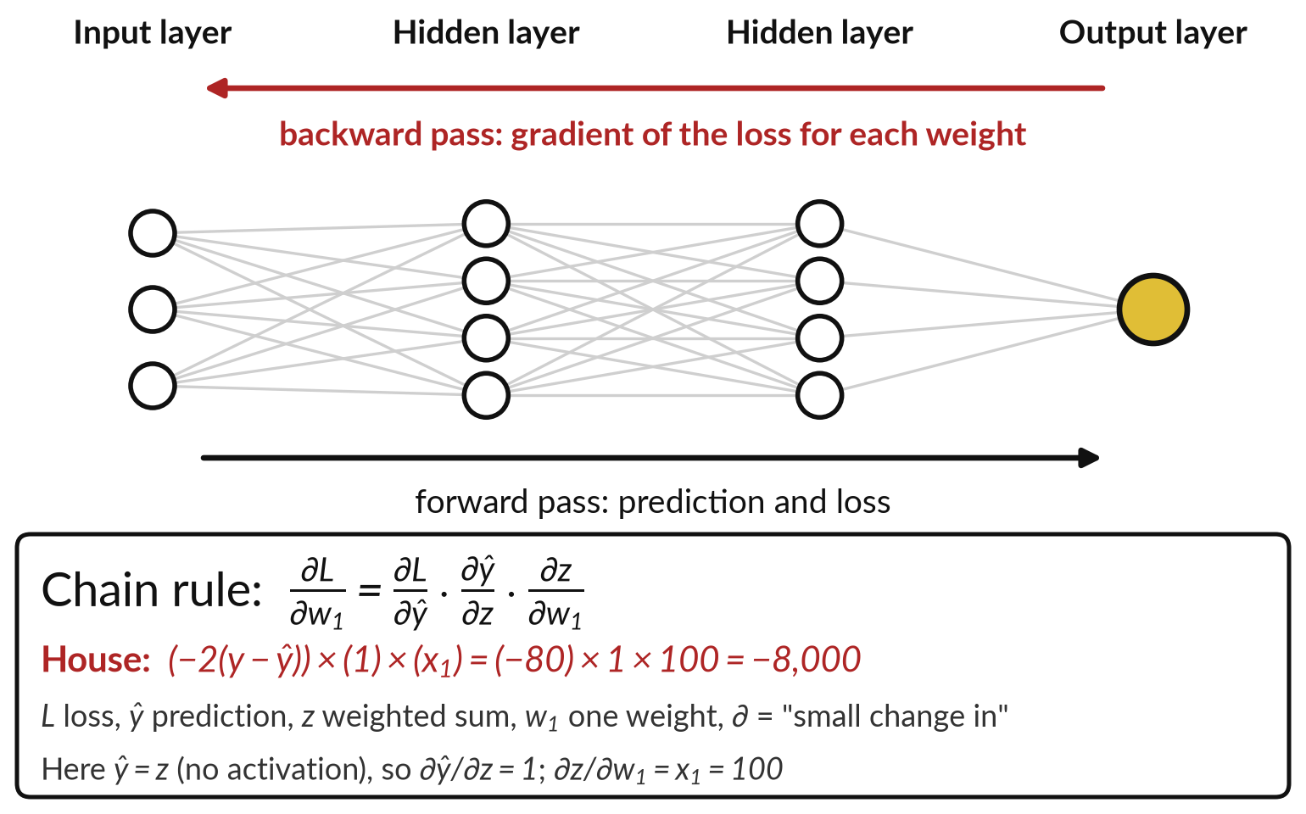
Backpropagation computes the gradient for
every weight, from the output backwards
The forward pass makes the prediction and the loss. The backward pass works out each weight’s gradient.
It applies the chain rule of calculus, one layer at a time.
Gradient descent then uses these gradients to update every weight.
Three slopes multiplied: −8,000 here.
Notes:
Gradient descent needs a gradient for every weight, and in a neural network backpropagation provides them. A neural network is layers of neurons joined by weighted connections, each computing a weighted sum, a bias and an activation. In the forward pass, numbers flow through the layers and produce a prediction, and from it the loss.
Backpropagation then runs backward, using the chain rule: the gradient for a weight is the slope of the loss with respect to the prediction, times the slope of the prediction with respect to z, times the slope of z with respect to the weight. For our house that is minus 80, times 1, times 100, which is minus 8,000, the number we just used.
Gradient descent takes the step. Predict forward, gradients backward, update, repeat. In Session 1 we open a single neuron.

Slide 14
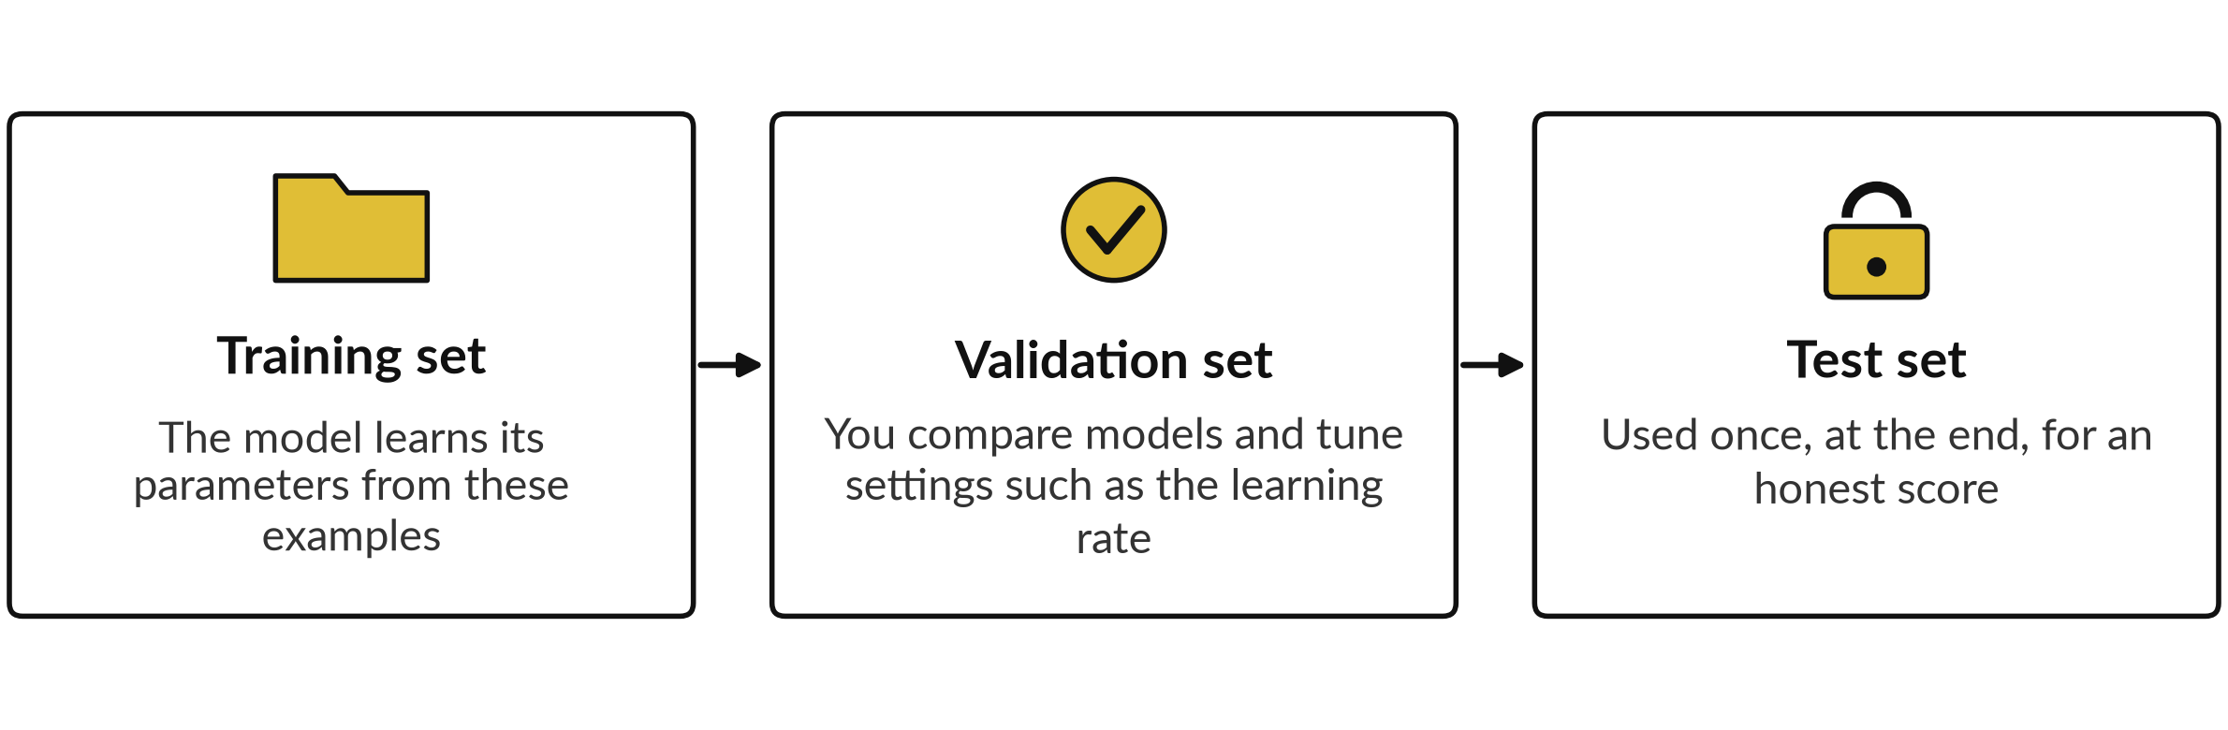
Split the data into training, validation and test sets
The test set stays locked until you have chosen your model.
Notes:
We have a model that learns. Our third block asks how we know it works, which protects you from a confident vendor. To find out whether a model really works, we split the data into three sets. Think of practice questions, a mock paper and the final paper.
The training set is what the model learns from. The validation set is used while you build, to compare versions and tune settings such as the learning rate. The test set stays locked away until the end and is used once for an honest score. If you keep checking the test set while you build, you start fitting the model to it, and the score stops being honest.
When a vendor quotes an accuracy figure, ask which set it was measured on.

Slide 15
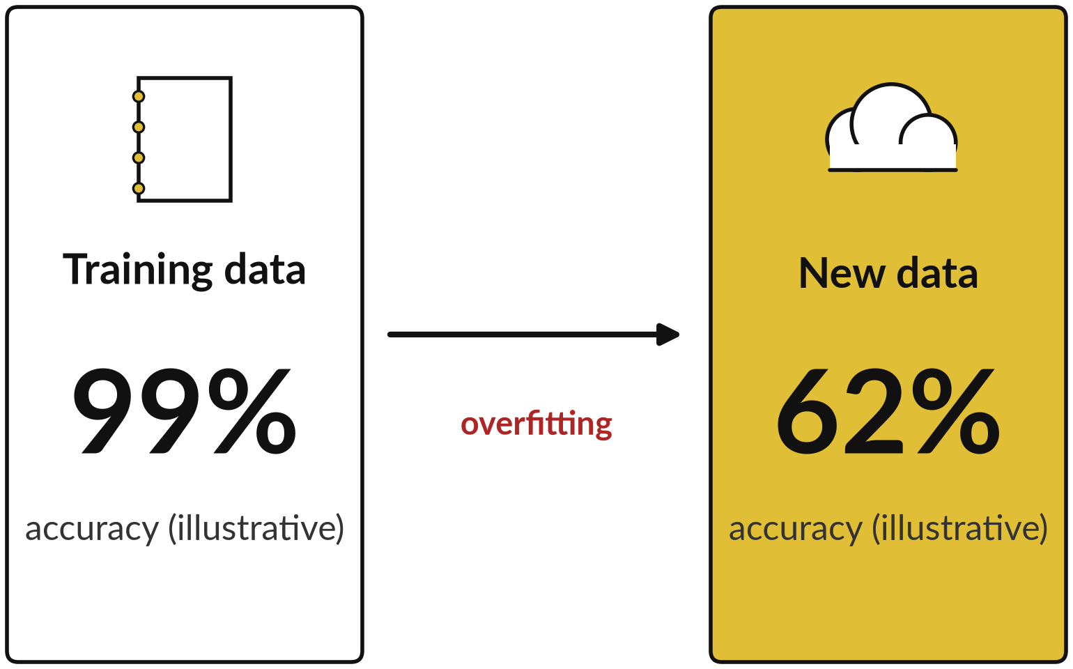
Overfitting: a model that fits its training data,
noise included, does worse on new data
Plainly put, the model has memorised its examples.
It looks excellent on training data and fails on unseen cases.
More varied data, a simpler model or stopping training earlier help.
A locked test set reveals it.
Notes:
Keeping the test set locked matters because of this problem. Overfitting is the most common way models disappoint. Say a house price model is shown only 20 houses. It can fit those 20 exactly, including the one sold cheaply to a relative, and then price a new house badly.
It has memorised the examples and their noise instead of learning the pattern. A student who memorises last year’s answers does the same. The numbers on this slide are illustrative, but the pattern is real: very high accuracy on training data and much lower on new data. The remedies are more varied data, a simpler model, or stopping training earlier.
Always judge on data the model has never seen. That is why a vendor demo on their own data tells you little.

Slide 16
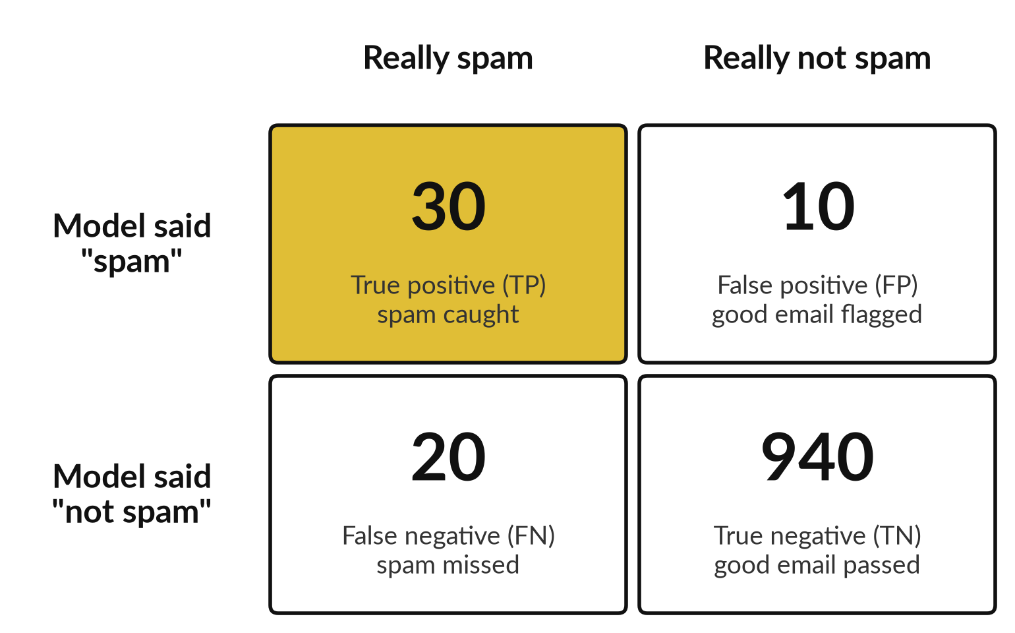
Accuracy alone can mislead: the confusion
matrix counts four kinds of outcome
A spam filter checks 1,000 emails. Fifty are really spam. These numbers are illustrative.
Accuracy = (TP + TN) / (TP + TN + FP + FN) = 970 / 1,000 = 97%.
A majority-class baseline that says not spam every time scores 95% and catches no spam.
Notes:
Honest testing needs an honest score, and the obvious one is accuracy, the share of answers that are right. Take a spam filter that checks 1,000 emails, of which 50 are really spam. The table of outcomes is the confusion matrix. A true positive is spam that was caught: 30.
A false positive is a good email wrongly flagged: 10. A false negative is spam that was missed: 20. A true negative is a good email correctly passed: 940. Accuracy is 970 out of 1,000, or 97 percent. But a baseline that always says not spam scores 95 percent and catches nothing.
The same table is used for fraud alerts on payments. Which mistake would hurt you more, a false alarm or a miss?

Slide 17

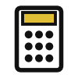
Precision, recall and F1 score
answer different questions
Measure and formula | The question it answers | In the spam example
Accuracy = (TP + TN) / total | How often is it right overall? | 970 of 1,000: 97%
Precision = TP / (TP + FP) | When it says spam, how often is it right? | 30 of 40: 75%
Recall = TP / (TP + FN) | Of the real spam, how much did it catch? | 30 of 50: 60%
F1 score = 2PR / (P + R) | One number that balances precision and recall | 2 × 0.75 × 0.60 / 1.35 = 0.67
P is precision and R is recall, so F1 is their harmonic mean. Raising the threshold usually lifts precision and lowers recall.
Notes:
Your answer to that decides which measure matters, and the four counts give us the rest. The threshold is the score above which the model flags an email; more on that in a moment. Precision asks: when the model says spam, how often is it right?
Thirty of forty, so 75 percent. Recall asks: of the real spam, how much did it catch?
Thirty of fifty, so 60 percent. The F1 score, the harmonic mean of the two, is two times precision times recall, divided by precision plus recall: 0.67 here. Accuracy, precision and recall answer different questions, so you cannot read one alone. For fraud, recall is the share of real fraud caught. When a vendor quotes one figure, ask for the other two.

Slide 18
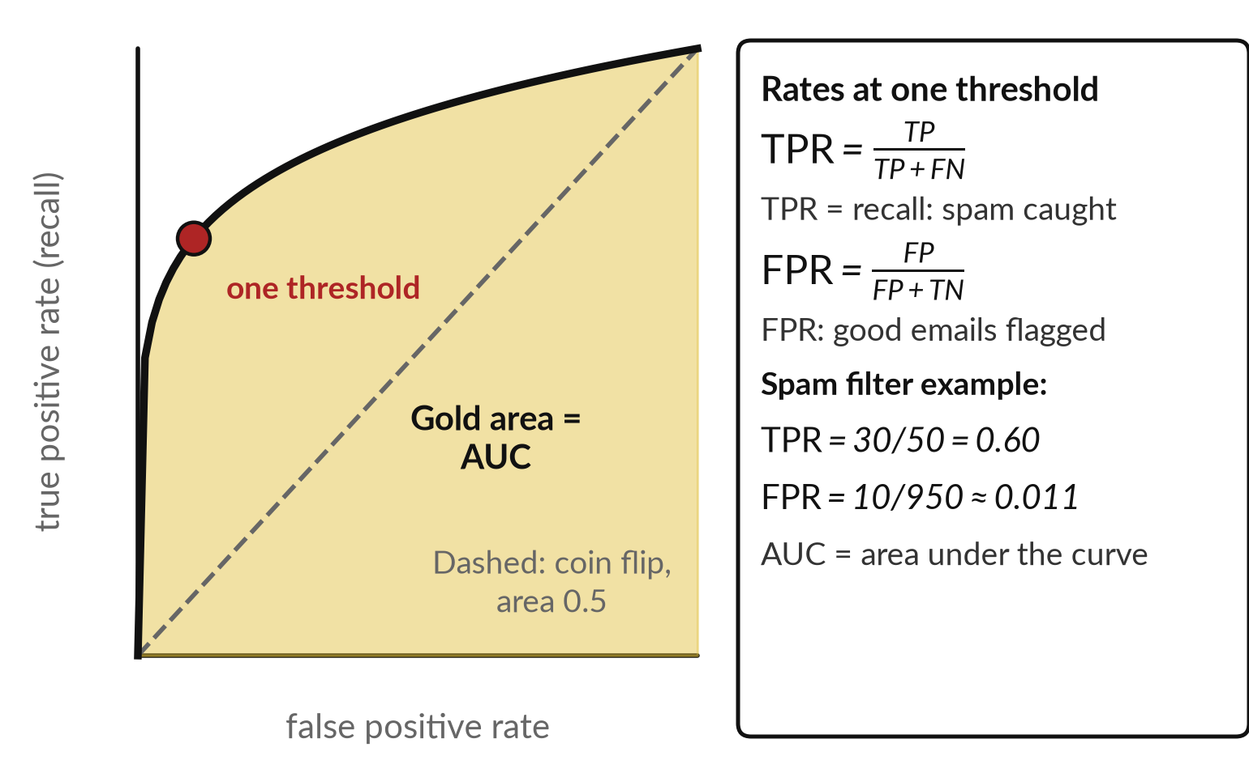
The ROC curve and AUC show
a classifier at every threshold
Each point is one threshold: the share of real spam caught against the share of good emails wrongly flagged.
AUC, the area under the curve, is 1.0 for a perfect model and 0.5 for a coin flip.
This picture shows about 0.86 (illustrative).
For rare events, also check precision.
Notes:
Those figures depend on one choice, the threshold, so the next picture shows every choice at once. A classifier scores each email, and above the threshold you flag it. The ROC curve, short for receiver operating characteristic, shows what happens at every threshold. Each point is one setting: the true positive rate, recall, which is TP over TP plus FN, against the false positive rate, FP over FP plus TN, the share of good emails wrongly flagged.
Ours: 30 over 50, and 10 over 950. The dashed line is a coin flip. The area under the curve is called AUC. One point zero is perfect, and zero point five is no better than chance. Here it is about 0.86, which is illustrative. AUC compares models well.
For rare events, also look at precision, because AUC can look good while most flags are false alarms.

Slide 19
Pick the measure that fits the task
Task | Common measures | The question to ask
Yes or no, or a category | Precision, recall, F1 score, AUC | What does a miss cost, and a false alarm?
Predicting a number | MAE and RMSE | How far off is a typical price, in our units?
Ranking and suggestions | Top-k hit rate | Is the right film in the first few suggestions?
Language models | Groundedness, citation accuracy, human review | Is the answer supported by our documents?
MAE = (1/n) Σ |y − ŷ| is the average miss. RMSE = √MSE punishes big misses more. Houses off by 40 and 20: MAE 30, RMSE 31.6.
Notes:
So far every measure has been for yes or no questions, but not every task is one. For yes or no and category tasks, use precision, recall, F1 score and AUC. For predicting a number, such as a house price, use the mean absolute error, MAE, the average size of the miss, and the root mean squared error, RMSE, the square root of the average squared miss, which punishes big misses more.
Two houses missed by 40 and 20 give an MAE of 30 and an RMSE of 31.6. For ranking, such as films to watch, ask whether the right item is in the first few results, the top-k hit rate. For language models there is no single score: look at whether answers are supported by your documents, whether citations are right, and what reviewers say.
For any figure quoted to you, ask which data and what threshold.

Slide 20


Benchmarks compare models,
but they do not test your task
What they give you
Their limits
Standard questions every model answers
Scores for knowledge, coding and maths
Public rankings built from human votes
Test answers can leak into training data
Many scores are published by the vendor
Your documents and risks are not in them
Use them to shortlist, then test on 50 of your own questions.
Notes:
Vendors rarely walk you through all of that. They usually quote a benchmark instead, so here is what those are worth. A benchmark is a standard set of test questions that every model answers, so scores can be compared. MMLU tests broad knowledge, HumanEval tests writing code, and Chatbot Arena ranks models by human votes.
They are useful for a shortlist. But they have limits. Test answers can leak into the training data, many scores are published by the vendor itself, and none of them contain your documents, your language or your risks. So use benchmarks to shortlist, then test the finalists on fifty of your own questions with known answers.
Session 6 reads benchmarks closely, and Session 10 shows how to build your own test set.

Slide 21
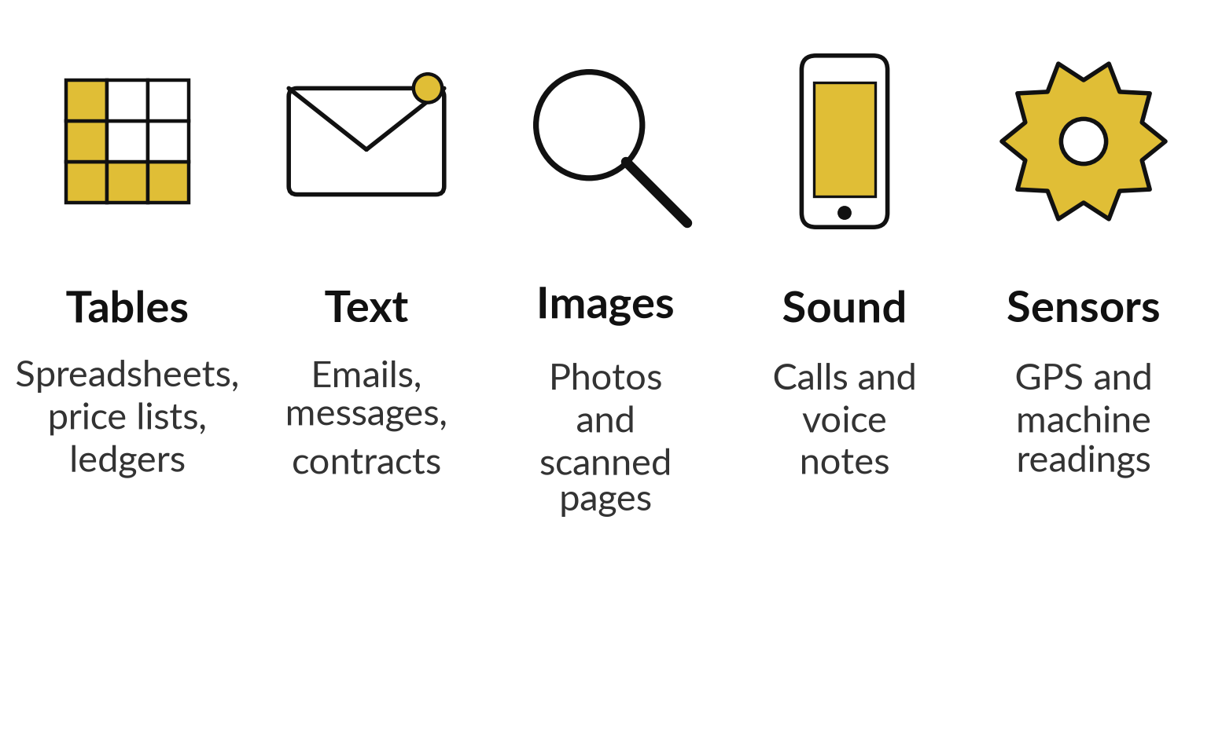
Companies hold five kinds of data,
and most of it is unstructured
Tables are structured data. Text, images and sound are unstructured.
Labelled data has the correct answer attached.
Unlabelled data does not.
A time series is data in order of time, such as daily sales.
Notes:
Every score we have discussed depends on data, so after the break our fourth block is data: what you hold, whether it is good, and whether it is ready. Data is the raw material. Companies hold tables such as spreadsheets and ledgers; text such as emails and contracts; images such as photos and scanned pages; sound such as calls and voice notes; and sensor readings such as GPS and machine data.
Tables are called structured data. The rest is unstructured, and it is most of what a company holds. Data may also be labelled, with the correct answer attached, which supervised learning needs, or unlabelled. And a time series means values in order of time, like daily sales. Which kind does your task use?

Slide 22


Data quality decides what a model can learn
Completeness: no large gaps.
Accuracy: figures match the source.
Timeliness: not out of date.
Consistency: one name and one format for one thing.
Representativeness: it covers the cases you will meet.
Notes:
Knowing the kinds of data is one thing; knowing whether it is any good is another. A model can only learn from what it is shown. These are five standard dimensions of data quality. Completeness: are there large gaps? Accuracy: do the figures match the source?
Timeliness: is the data current, or out of date?
Consistency: is there one name and one format for one thing, such as one spelling of a supplier?
And representativeness: does it cover the cases the model will meet?
If the data under-represents a group of customers, the model will be worse for them. That is how bias enters. And personal data is covered by the Data Protection and Privacy Act, 2019, so check your duties with a lawyer.

Slide 23
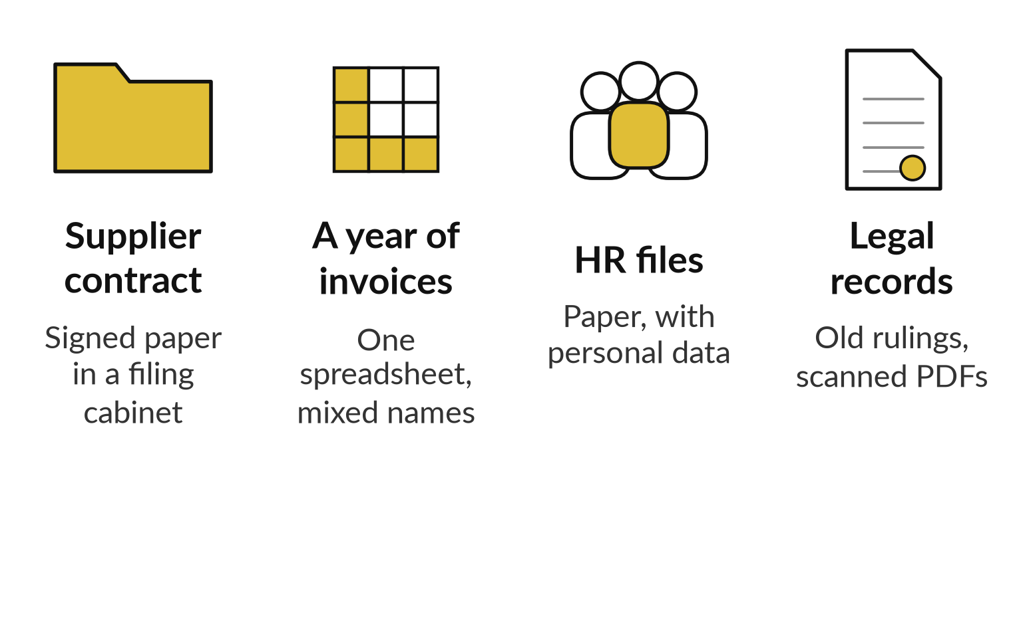
Is your data ready for AI? Nile Valley
Foods shows the questions to ask
Nile Valley Foods, our example company, keeps its records in four places and four formats.
A scan is only a picture until text is read from it.
AI can use only what is readable, findable and allowed.
Notes:
Quality in general is useful, but the practical question every organisation faces is this: is our data ready for AI?
Take Nile Valley Foods and four sets of records. A supplier contract exists only as signed paper in a filing cabinet. A year of invoices sits in one spreadsheet, with the same supplier spelled three ways. HR files are on paper and hold personal data. And the legal records room holds old rulings as scanned PDFs of mixed quality. A model cannot use paper. A scan is only a picture until text is read from it. And nothing should be used until you know who owns it and whether it is confidential. So readiness has three tests: is it readable, is it findable, and is it allowed? Finance, HR, operations and legal all face the same three tests.

Slide 24





Score each area before you
spend: the readiness scorecard
Area | Ask | Red flag
Inventory | Do we know what exists and where? | No list; paper in boxes
Readable | Can a machine read the text? | Scans are crooked or faint
Complete and unique | Are there gaps and duplicates? | Ten copies of one contract
Metadata | Owner, date, type, version? | Only a file name
Rights | Who may use it, and for what? | Personal data unchecked
Current | Is it up to date? | Expired contracts mixed in
Notes:
Those three tests need a way of scoring, so here is the scorecard. Before spending, score the data on six areas. Inventory: do we know what exists and where?
Readable: can a machine read the text, or are scans crooked and faint?
Complete and unique: are there gaps, and ten copies of the same contract?
Metadata: do we know the owner, date, type and version, or only a file name?
Rights: who may use it and for what, including personal data and confidential client material?
And current: are expired contracts mixed in with live ones?
Score each green, amber or red. In Session 14 you do this for your own organisation, with two points for green, one for amber and none for red, out of twelve. A red on rights stops the project until a lawyer has looked at it. Where does your biggest red sit?

Slide 25
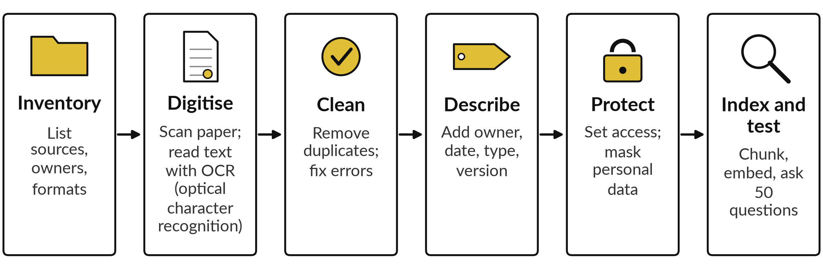
Six steps turn scattered
records into AI-ready data
Start with one folder and one year. Test it, then widen.
Notes:
A scorecard shows the gaps, and six steps close them. Six steps take Nile Valley Foods from scattered records to AI-ready data. One, inventory: list every source, its owner and its format. Two, digitise: scan the paper and run OCR to read the text. Three, clean: remove duplicates and fix obvious errors.
Four, describe: add owner, date, type and version as labels. Five, protect: set who can see what, and mask personal data where needed. Six, index and test: chunk the text into passages, embed each as a vector of numbers, index them, then ask fifty real questions with known answers and measure what comes back.
Start small, with one supplier folder and one year. Skipping the testing step is the usual mistake.

Slide 26


Preparing data to search it is lighter
than preparing it to train a model
For retrieval (RAG)
For training or fine-tuning
Readable text with labels
Cut into chunks and indexed
Updated when documents change
Answers can cite the source
Right to use the data confirmed
Personal data removed
Formatted as examples, such as question and answer pairs
Split into train, validation and test sets
Prepare for retrieval first.
Notes:
Step six prepared the data for search, which is only one of two ways to use it. Preparing data depends on what you want to do. To search it, which is retrieval-augmented generation, RAG, where the system finds relevant passages and gives them to the model with your question, you need readable text with labels, cut into chunks and indexed, kept up to date, so answers can point to the source.
To train or fine-tune a model, you need more. You need a confirmed right to use the data, personal data removed, quality filtered, the content formatted as examples such as question and answer pairs, and split into training, validation and test sets. That is a bigger project. So most organisations should prepare for retrieval first, and consider fine-tuning only when prompting and retrieval have clearly reached a limit. Check your duties with a lawyer.

Slide 27
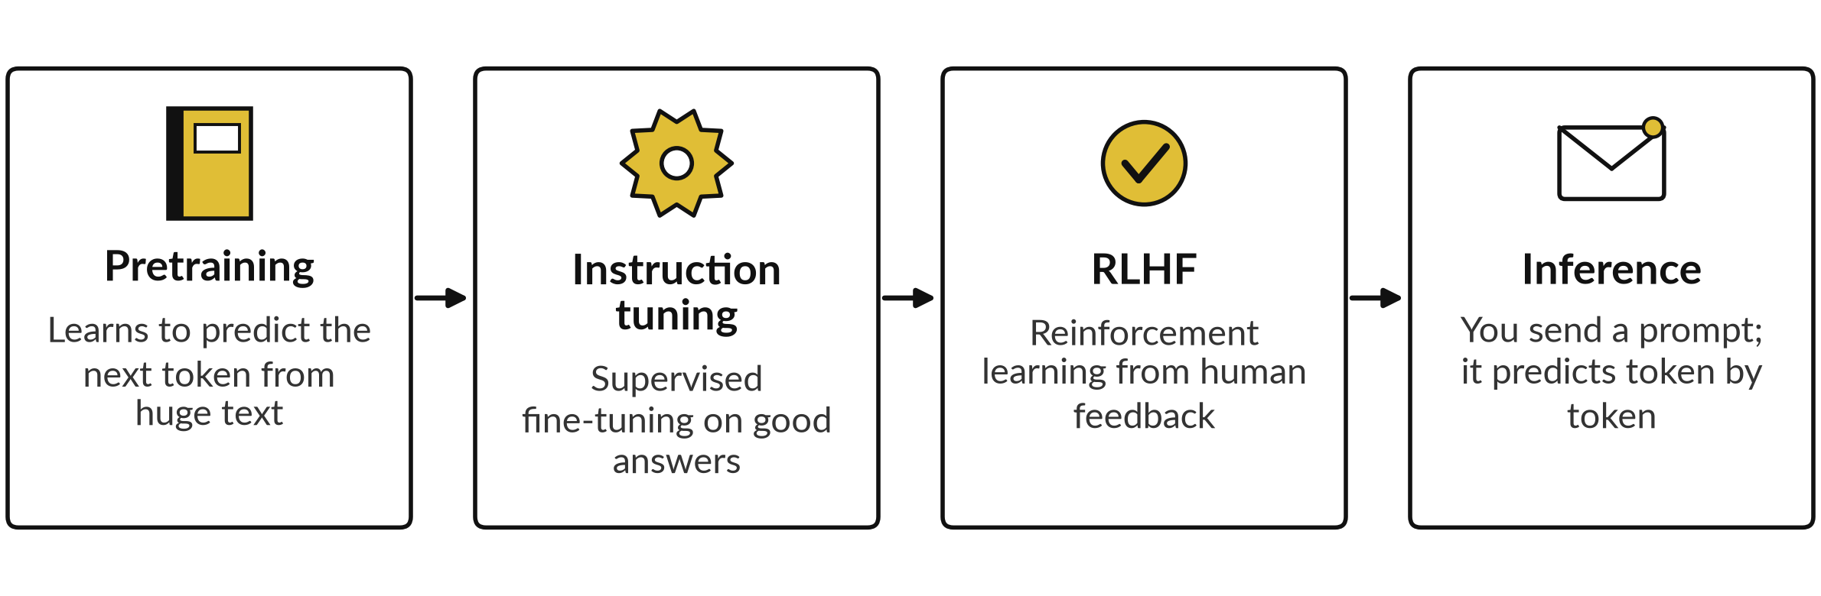
A large language model is trained in stages
Pretraining gives a base model; the next two are post-training (Session 6). A token is a word or part of a word. It writes likely text; it does not look facts up unless search or files are on.
Notes:
With the data in place, our fifth block is language models and what happens behind a chat answer. How does an assistant come about?
First, pretraining: the model reads a huge amount of text and learns to predict the next token, a token being a word or part of a word. That is the self-supervised learning we saw, and it gives a base model. Then post-training. Instruction tuning, a kind of supervised fine-tuning, shows it instructions with good answers.
In reinforcement learning from human feedback, RLHF, people rank answers and the model is trained to prefer the better ones. The result is an instruction-tuned model. When you use it, that is inference. It predicts likely text. It does not look facts up unless search or files are on, which is why a hallucination can sound sure.

Slide 28
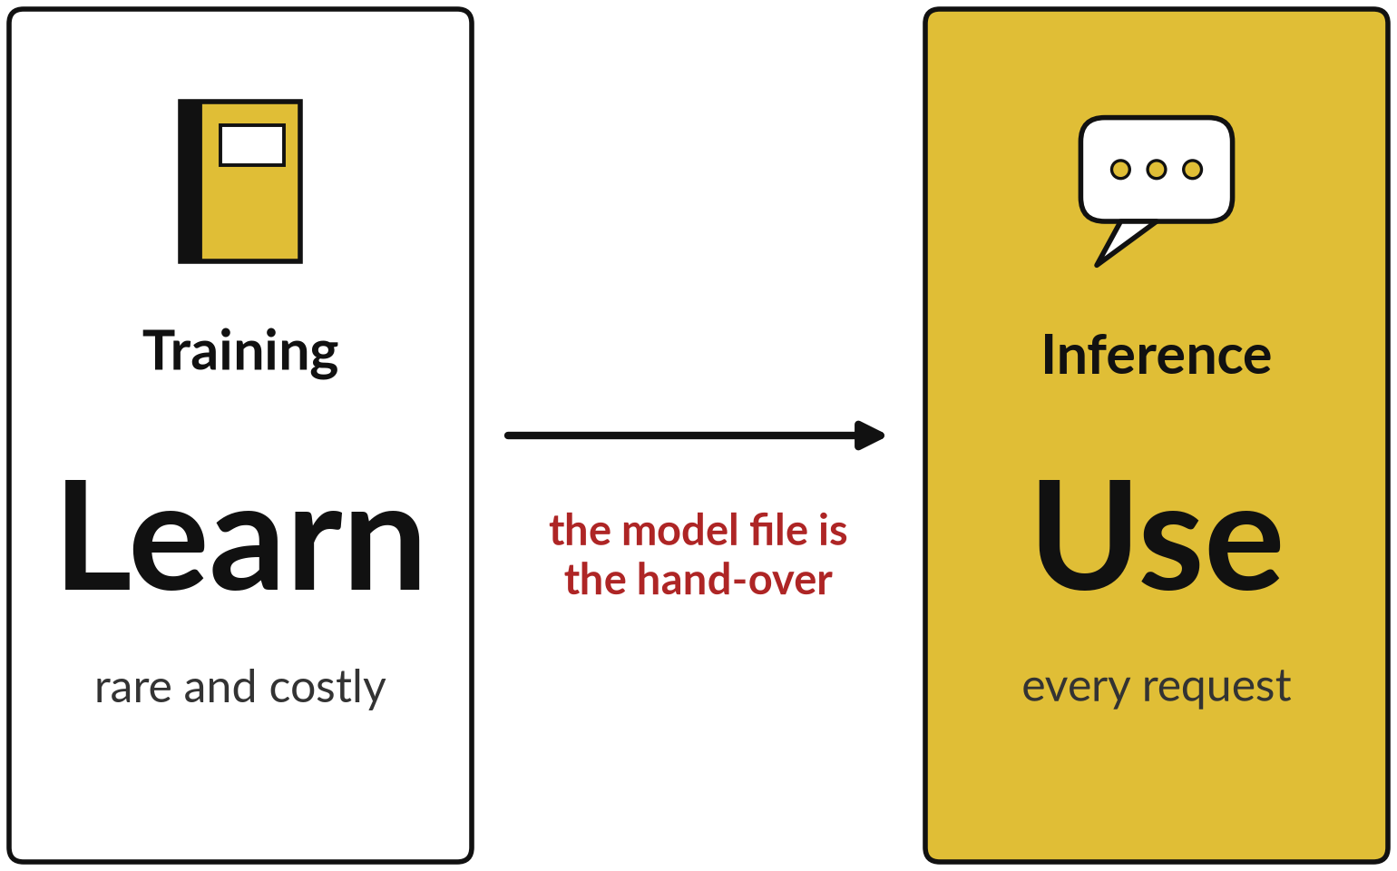
Training builds the model once;
inference uses it every time
Most companies only ever do inference.
Training needs large data and heavy computing.
Inference needs speed, and its cost grows with use.
Notes:
Two of the words in that picture, training and inference, explain a lot of the cost and the risk. Training is the learning phase we described earlier. It is rare, needs large data and heavy computing, and produces a model file. Inference is using that model, every time someone sends a request.
It must be fast, and its cost grows with the number of requests. Most companies never train anything. They pay for inference, or run an existing model themselves. When a vendor says it trained on your data, ask whether they mean training, or only that your files are searched at inference time. Those are very different.

Slide 29
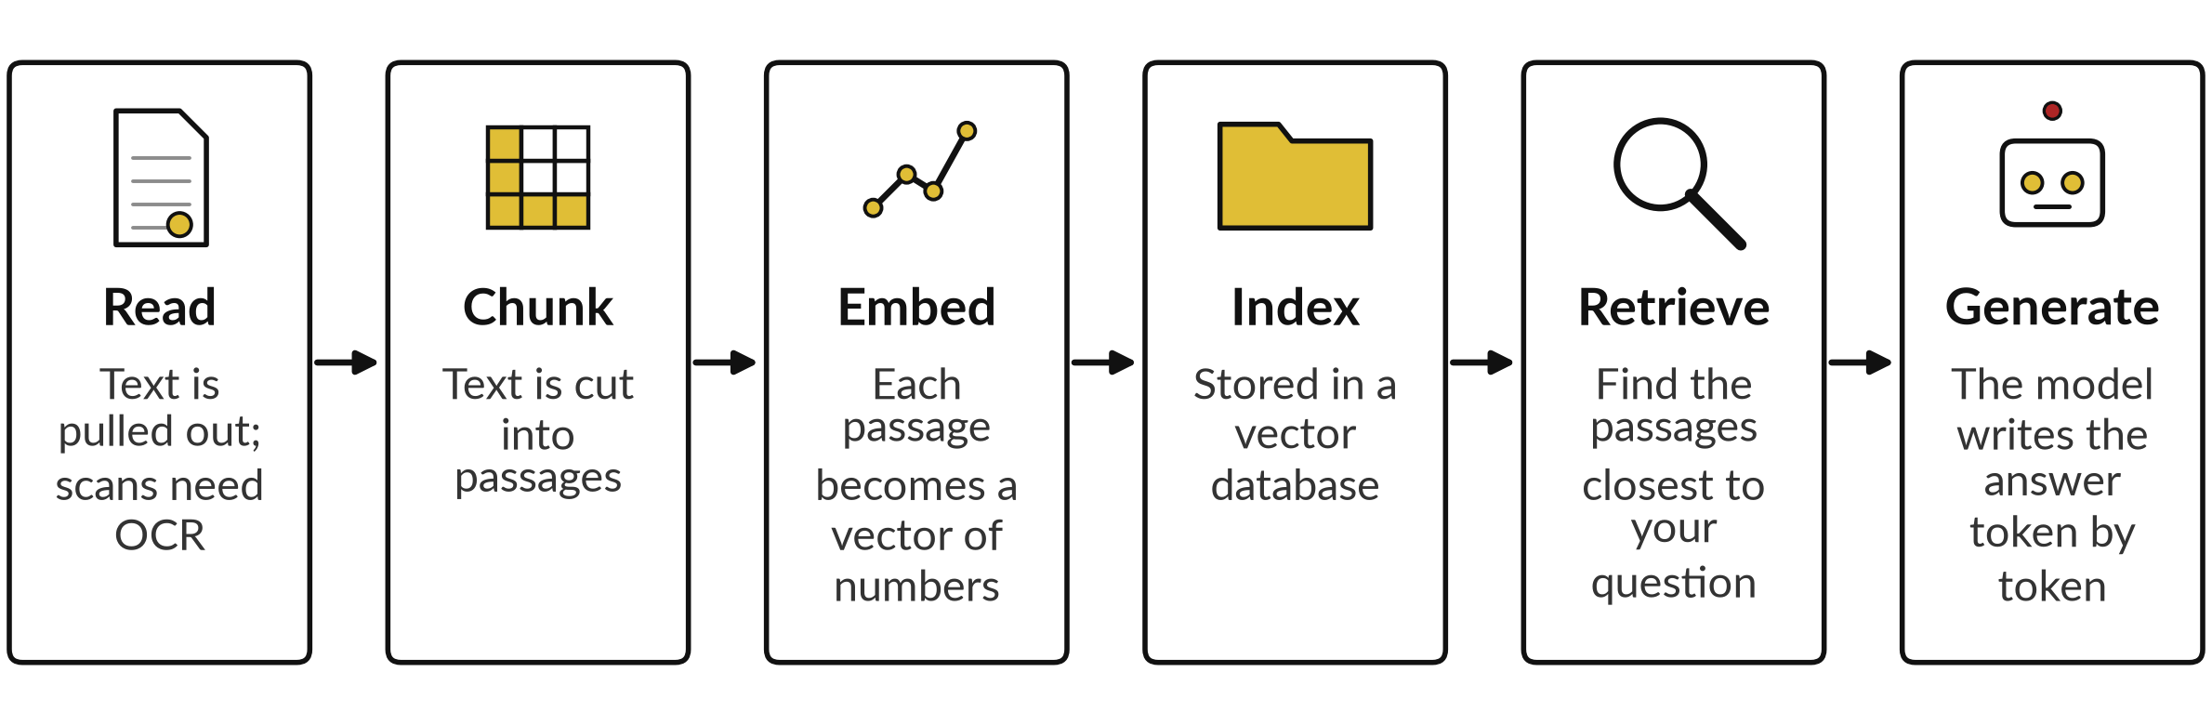
Behind the screen: how retrieval-augmented
generation (RAG) answers from a file
With no file, only the last step runs: your words become tokens and the model predicts the reply.
Notes:
Inference sounds abstract, so let us look behind the screen at retrieval-augmented generation, RAG. You type a question and attach a contract. First the system reads the file and pulls out the text. A scan needs optical character recognition first. The text is cut into passages called chunks.
Each chunk is turned into an embedding, a list of numbers that captures its meaning. The embeddings are stored in an index, often called a vector database. Your question is also turned into an embedding, and the closest chunks are retrieved. The question, those chunks and the rules are assembled into one prompt.
The model then writes the answer one token at a time, and may cite the chunks. With a short file, many products simply place the whole file in the prompt. Details differ by vendor.

Slide 30



Each stage can fail, and the
failure shows in the answer
Stage | What it does | What can go wrong
Read | Gets text out of the file | A scan is misread; tables scramble
Chunk | Cuts text into passages | A clause is split across two chunks
Embed and index | Stores meaning as vectors | The index is out of date
Retrieve | Finds the closest passages | The wrong passage returns; permissions are ignored
Generate | Writes the answer from them | It adds claims the passages do not support (hallucination)
Notes:
That is a long chain, and a long chain has many places to break. Each stage can fail, and the failure shows up in the answer. If the scan is misread at the first stage, everything after is built on errors. If a clause is cut across two chunks, the model may see half of it.
If the index is old, you get yesterday’s answer. If retrieval returns the wrong passage, the model answers confidently from it. If the system ignores who may see which file, a person can read what they should not. And at the last stage the model can add claims the passages do not support.
So when an answer is wrong, ask which stage failed. Session 9 shows the retrieval step in detail, and Session 10 shows how to test it on your own documents.

Slide 31
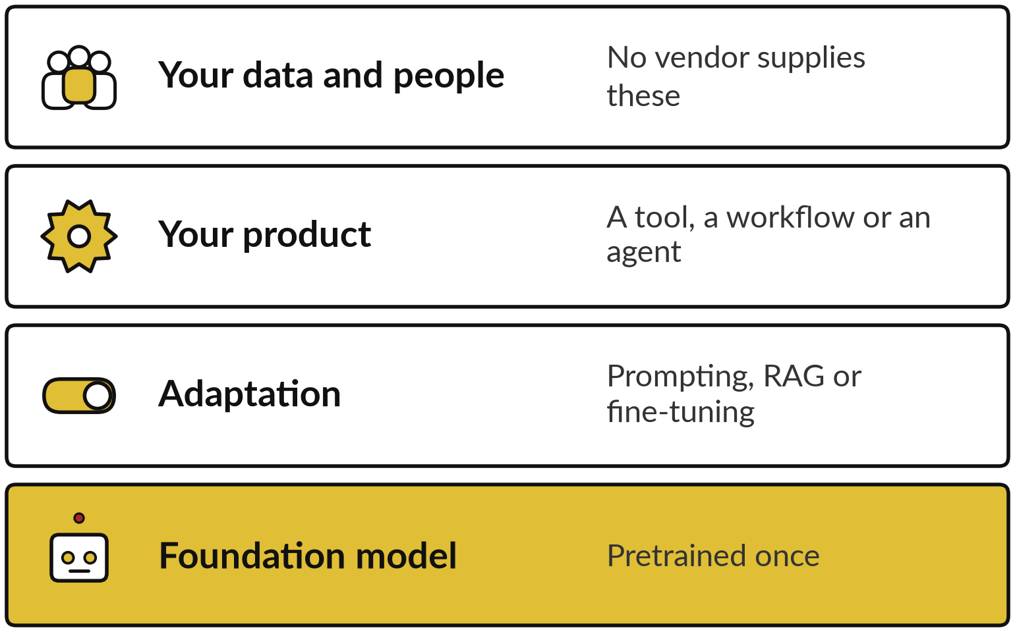
Most companies use a foundation
model that someone else trained
A foundation model is a large model pretrained once on broad data, then adapted to many tasks.
A large language model (LLM) is a foundation model trained on text.
Pretraining one needs huge data and computing power.
You choose which to rent or download.
Notes:
Our sixth block covers what you actually buy: foundation models, the choices around them and the costs. You will be able to say what you are renting and what it costs you. Most companies do not train their own large model. A foundation model is a very large model trained once on broad data, then adapted to many tasks.
Training one takes a very large amount of data and computing power, so only a few organisations do it. What you choose is which one to rent or download, and how to adapt it. Think of four layers. The foundation model sits at the bottom. Your adaptation sits above it: prompts, retrieval or fine-tuning.
Your product sits on top: a tool, a workflow or an agent. And under all of it are your data and your people, which no vendor supplies.

Slide 32

Proprietary or open weights: you
choose convenience or control
Proprietary, rented
Open weights, downloaded
Reached by subscription or API
Little set-up; the vendor maintains it
Your data goes to the vendor
Trained weights published; you run inference yourself
You control where data goes
Needs skills and hardware
The licence may still limit use
Open does not mean free or simple: you still pay to run and care for it.
Notes:
Once you accept that you are renting a model, the first choice is proprietary or open. A proprietary model is reached by subscription or through an API. Set-up is easy and the vendor maintains it, but your data goes to the vendor under its terms. An open-weights model has its trained parameters published, so you can download them and run inference on your own servers, which gives you control over where data goes.
You then need skills and hardware. Open weights is not the same as open source in the Open Source Initiative sense. The word open can mislead. Many open models carry licences that limit some uses, so read the licence. Open does not mean free or simple, because you still pay for running and care.
For most companies starting out, a proprietary tool with clear data terms is usually the quicker path.

Slide 33


Four ways to adapt a model, from cheap to costly
Method | What it changes | Use it when
Prompting | The instructions you give | Always start here
Retrieval (RAG) | The facts the model can see | Answers must come from your documents
Fine-tuning (LoRA) | The model’s parameters, a little: style and skills | You need a steady format or tone at volume
Pretraining from scratch | Everything | Almost never, for a company
Fine-tuning teaches style and skill. Retrieval supplies facts. Most business needs start with prompting and retrieval.
Notes:
Whichever model you pick, you then adapt it to your work, and there are four ways, from cheap to costly. Prompting changes the instructions you give. Always start there. Retrieval-augmented generation, RAG, changes the facts the model can see, so answers come from your documents. Fine-tuning changes the model’s parameters a little, teaching it a style or a skill, such as a steady format.
A common method, LoRA, short for low-rank adaptation, trains small add-on adapters instead of the whole model. Fine-tuning does not reliably teach new facts. Pretraining from scratch changes everything and is almost never right for a company. So the rule: fine-tuning teaches style and skill, retrieval supplies facts.
Most business needs are met by prompting and retrieval. Each of these choices has a price, so let us finish with cost.

Slide 34



AI has five costs beyond the licence
Usage: tokens processed at inference, or seats.
Data preparation: digitising, cleaning, describing.
Set-up and integration with your systems.
People: review time, training and owners.
Monitoring, upkeep and switching later.
Notes:
Each of those choices carries a price, so finally, cost. The subscription is only the first line. Usage: language models are priced by tokens, a token being a piece of a word, for what goes in and what comes out, or by the seat. Data preparation: digitising, cleaning and describing your documents takes more effort than most people expect.
Set-up and integration: connecting the tool to your systems. People: review time, training and owners. And monitoring and upkeep, plus the cost of switching vendors later. I give no prices here, because they change often. Session 7 does the running-cost sums, and Session 12 builds your business case.

Slide 35
What AI does well and what it does badly
Does well
Does badly
Finding patterns in large amounts of data
Drafting and summarising text
Working fast, without tiring
Sorting and flagging for a person to check
Knowing which fact is true (hallucination)
Rare events it has seen little of
Judging fairness or consequences
Staying correct when the data changes (drift)
Use it where a quick check can catch a mistake.
Notes:
That closes the technical part, so here is a balanced picture of what AI is good and bad at. AI does well at finding patterns in large amounts of data, drafting and summarising, working fast without tiring, and sorting or flagging things for a person to check. It does badly at knowing which fact is true, at rare events it has seen little of, at judging fairness or consequences, and at staying correct when the world changes.
The practical rule for the whole course: use AI where a quick check can catch a mistake. Keep people on decisions that carry risk. Session 10 turns that rule into a checking routine.

Slide 36







Where AI is used across industries
Industry | Typical use | Field
Banking and mobile money | Fraud alerts, credit risk | Anomaly detection, supervised learning
Agriculture | Crop disease from photos, price forecasts | Vision, forecasting
Retail and distribution | Demand and route planning | Forecasting
Health administration | Notes, scheduling, triage support | Language, speech
Human resources | CV screening, with bias risk | Language, supervised learning
Customer service | Assistants, enquiry sorting | Language
Finance and accounting | Invoice reading and matching | Vision, language
Notes:
Our seventh block is industry: the same few fields at work in real businesses, so you can spot which uses are close to yours. Here is how those fields show up. In banking and mobile money: fraud alerts and credit risk. In agriculture: reading crop disease from photos and forecasting prices.
In retail and distribution: demand and route planning. In health administration: notes, scheduling and triage support. In HR: CV screening, which carries a bias risk. In customer service: assistants and enquiry sorting. In finance: invoice reading and matching. Notice that the same few fields keep appearing. Which row is closest to your business, and which is furthest?

Slide 37
Who does what: the roles behind AI work
Role | What they do | Where you meet them
Data engineer | Builds the pipes that bring clean data in | Session 14
Data analyst | Explains what happened, with tables and charts | Sessions 12 and 14
Data scientist | Builds and tests models that predict | Sessions 2 and 3
ML engineer | Makes a model a reliable product | Sessions 7 and 9
Role | What they do | Where you meet them
MLOps (machine learning operations) engineer | Runs training, release and monitoring | Sessions 7 and 10
Applied AI engineer | Builds with ready-made models | Sessions 8, 9 and 11
AI researcher | Invents new methods, mostly in labs | Not in this course
Product or governance lead | Chooses uses, sets rules, checks value | Sessions 12 to 14: your seat
Notes:
Behind each of those uses are people, so the next block is roles, and by the end you can say who to ask for what. A data engineer builds the pipes that bring clean data in. A data analyst explains what happened, with tables and charts. A data scientist builds and tests models that predict or classify.
A machine learning engineer turns a model into a reliable product. An MLOps engineer builds the systems that train, release and monitor models safely. An applied AI engineer builds with ready-made models, which is closest to this course. An AI researcher invents new methods, mostly in labs. And the product or governance lead chooses the use cases and sets the rules.
That seat is yours. A data steward, noted below, owns the quality and rights of the data. In a small company one person does several of these jobs.

Slide 38
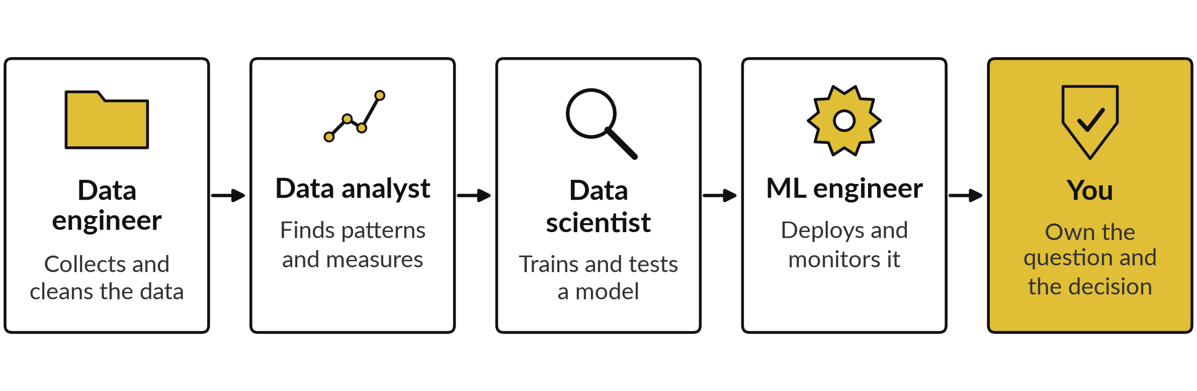
The roles hand work to each other in a line
At every step, a leader owns the question, the rules and the decision.
Notes:
Eight jobs can sound like a crowd, so here is how they hand work along. The data engineer collects and cleans the data. The analyst finds patterns and measures. The scientist trains and tests a model. The machine learning engineer deploys and monitors it. And at every step, a leader owns the question, the rules and the decision.
That is the seat you occupy, whatever your title. If your company has none of these people, you can still do this work with ready-made tools, and that is the route the practical sessions, twelve to fourteen, take. Where in this line would you want a specialist in your company?

Slide 39
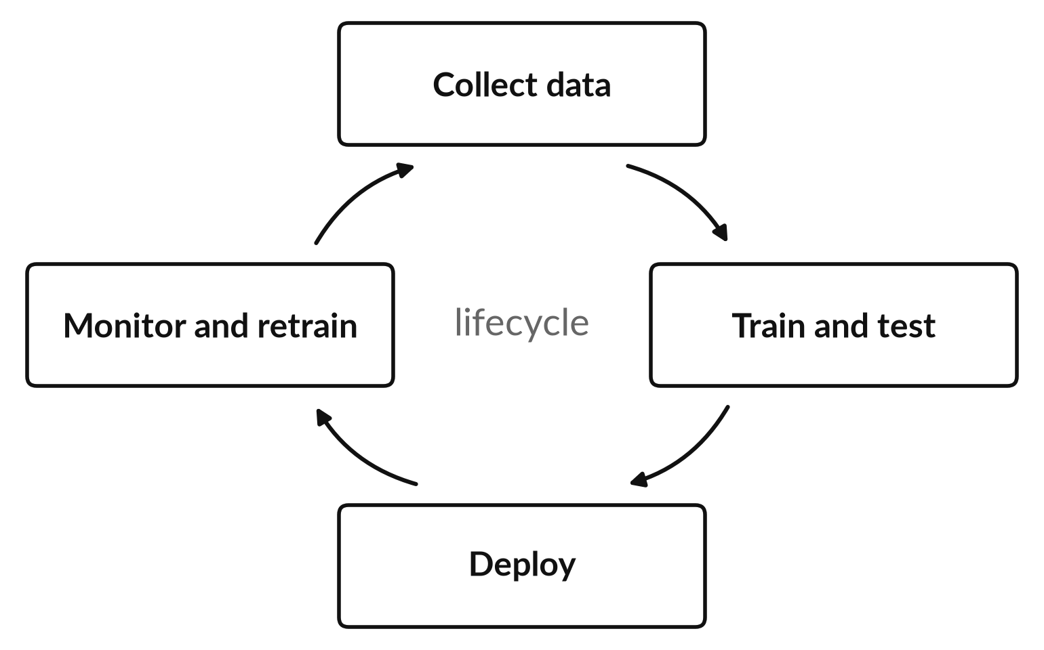
A model is never finished: it is trained,
tested, deployed and watched
The world changes, so a model’s performance drifts.
Data drift: today’s data no longer looks like the training data.
Someone must own the monitoring and the off switch.
Every AI project needs an owner after the purchase.
Notes:
Once the line has handed over a deployed model, the work still goes on. A model is not finished when it is trained. It is collected, trained, tested, deployed, and then watched. Customers change, prices change, fraud tactics change, and the data today stops looking like the data the model learned from.
That is called drift, and accuracy slowly falls. So someone must own the monitoring and the off switch. This is why every AI project needs an owner after the purchase, and it is why Sessions 10, 13 and 14 spend time on limits, risk and ownership.

Slide 40
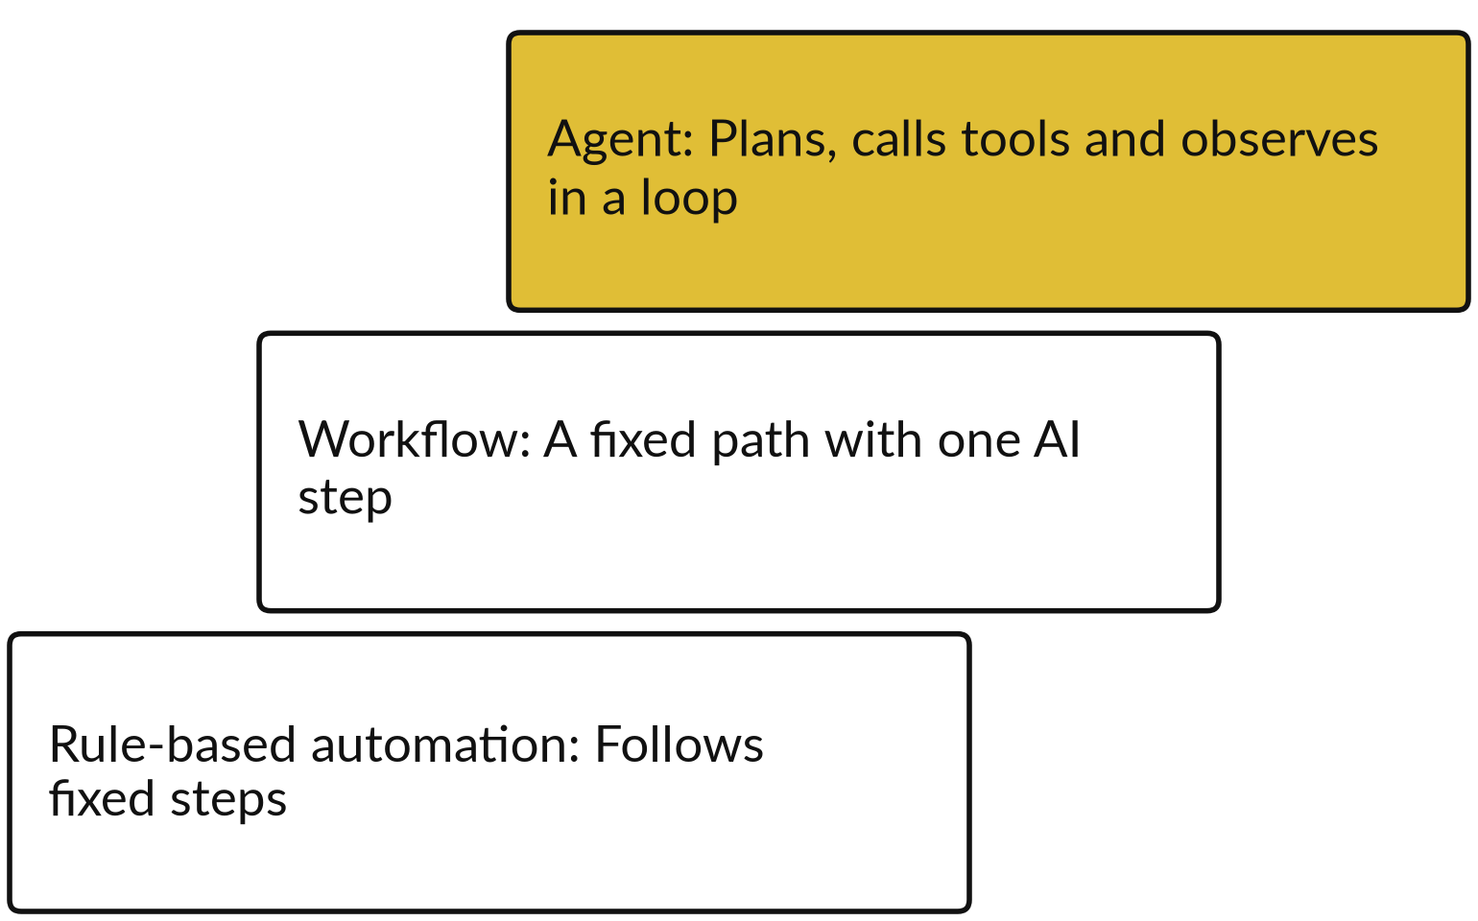
Rules, workflows and agents: the
more freedom, the more guardrails
An agent is a model that plans, uses tools (function calling) and checks the result, in a loop.
Session 11 shows how an agent works.
Session 12 maps your workflow onto the three levels.
Every step up needs guardrails and a human-in-the-loop approval step.
Notes:
Owning the off switch matters more as a system gains freedom, and that is the last picture before the roadmap. Automation comes in three levels. Rule-based automation follows fixed steps. A workflow follows a fixed path with one AI step inside it. An agent is given a goal and runs a loop: it plans, acts by calling tools, which is called tool use or function calling, observes the result and plans again.
Each step up gains flexibility and loses predictability, so it needs guardrails, which are limits on what the system may do, and a human-in-the-loop approval step before risky actions. In the course, Session 11 explains agents, and in Session 12 you map your own workflow onto these three levels.

Slide 41
The fourteen sessions at a glance
Session | You keep
1 Seeing: pixels and neurons | Sheet: a neuron on a house price
2 Learning from examples | Sheet: types, tree, k-NN
3 Measuring a model | Vendor question sheet
4 Words as numbers | Cheat sheet: four distance measures
5 Language models | Sheet: next-token prediction
6 Foundation models | Model comparison grid
7 Open weights, formats, cost | Rent, host or own sheet
Session | You keep
8 Prompting and reasoning | Prompt template and prompt log
9 Giving a model your knowledge | Prompt, RAG, fine-tune tree
10 When models fail | Check routine, evaluation set
11 Agentic AI | Tool Boundary Sheet (permissions)
12 Workflow mapping | Workflow map, hours saved
13 Governance and buying | Risk Register, policy, questions
14 Data readiness and roadmap | Inventory, roadmap, 90-day plan
Notes:
That is the map, so now let me show you the route. Here are all fourteen sessions and what you keep from each. Sessions one to eleven open the box, one idea at a time, with a demonstration in each. I run the demonstrations and you can join in whenever you like.
There is no coding and no homework. Sessions twelve to fourteen are practical, and we work together: first your workflow, then your AI policy and vendor questions, then your data readiness, roadmap and ninety day plan. The documents and templates are created in those last three sessions.

Slide 42





What you take home, and what happens next
The Course Handbook: today’s ideas with a glossary
The Course Overview and the Learner Workbook
A one-page take-away sheet from every session
Before Session 1: read the handbook, nothing else
Bring a laptop and an AI assistant account you already use
Sessions 12 to 14 are practical: you work on your own workflow, policy and data
Notes:
With the route clear, here is what you take home. The Course Handbook, with today’s ideas, pictures and a glossary. The Course Overview and the Learner Workbook. And after every session, a one page take-away sheet. Apart from reading the handbook, you have nothing to prepare for Session 1.
Bring a laptop and an AI assistant account that you already use, because some of my demonstrations let you join in. There is no coding and no homework. In the last three sessions we work together on your own workflow, your policy and your data. Before we close, what is the one question you still have?

Slide 43
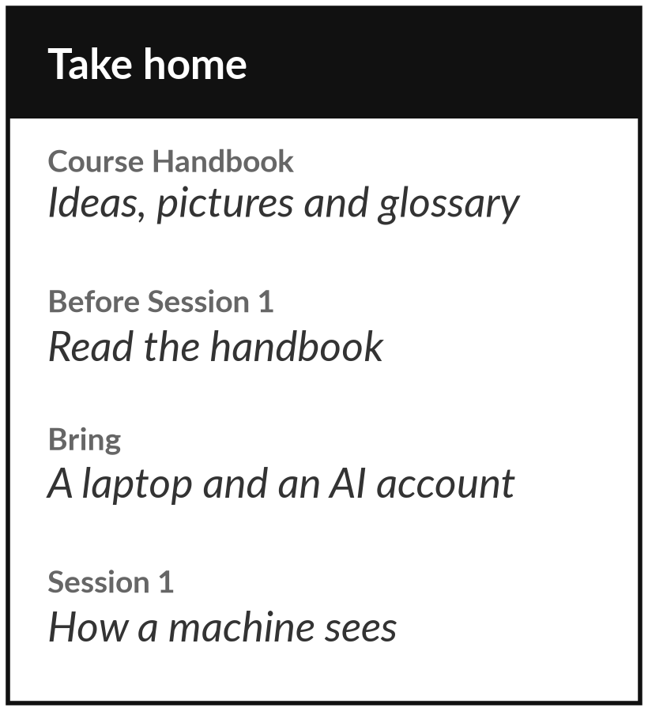
Take the handbook home
and read it before Session 1
What you keep from today
The Course Handbook, with today’s ideas, a glossary and what to prepare. Read it before Session 1, which begins with how a machine sees.
Our question today
What do I need to understand about AI before I decide anything about it?
Next session
Session 1: Seeing: pixels, features and neurons. Bring a laptop; nothing else to prepare.
Notes:
That brings us back to the question we began with, so before you go, here is what to take with you. The handbook repeats today’s ideas with pictures and has a glossary you can search. Reading it is the only preparation for Session 1, which begins with how a machine sees.
Bring a laptop and an AI assistant account you already use, because some demonstrations let you join in. If anything today was unclear, write the question down. We start Session 1 by answering it.
We began with this question: What do I need to understand about AI before I decide anything about it? Before you go, say in one sentence what you can now say about it.

